Slide 1

Online Plant Nursery Application

Slide 2
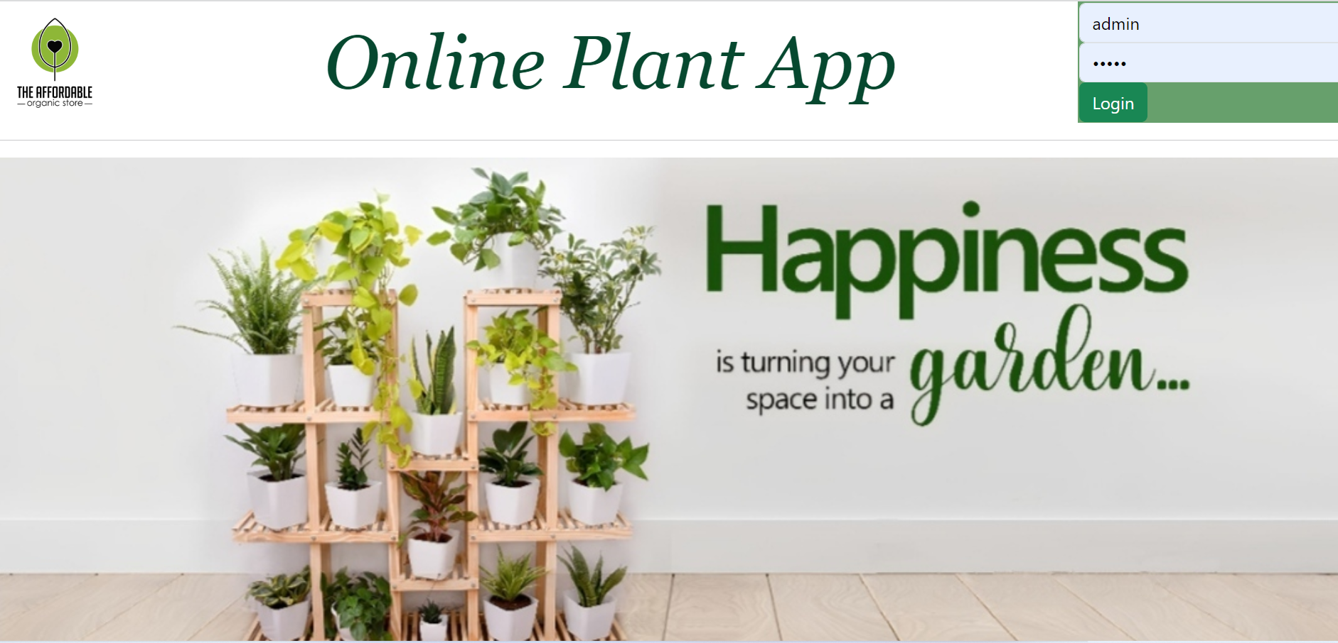
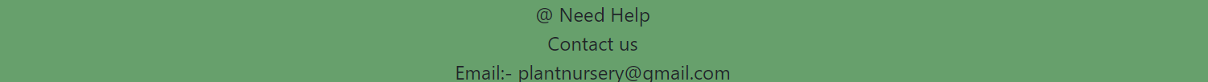
Webpage of our Project :-

Slide 3

Introduction
Online Plant Nursery Application is a web-based platform that allows users to browse, purchase and receive plants from the comfort of their homes.
The application typically offers a wide variety of plants, including planters and seeds.
Users can browse the inventory, select the plants they want, and place an order. The plants are then delivered to their doorstep or can be picked up at a designated location.
This application offers a user-friendly and accessible way for people to connect with nature and grow their own plants, regardless of their level of experience or location.

Slide 4
Modules
Login Module
Plants Management Module
OrderBooking Management module
Seeds Management Module
Planters
Management Module
Review Module

Slide 5
Technologies Used
Front End:
Html
Java-Script
Bootstrap
Angular
Back End:
Spring Boot
Pg-Admin
Post-Man

Slide 6
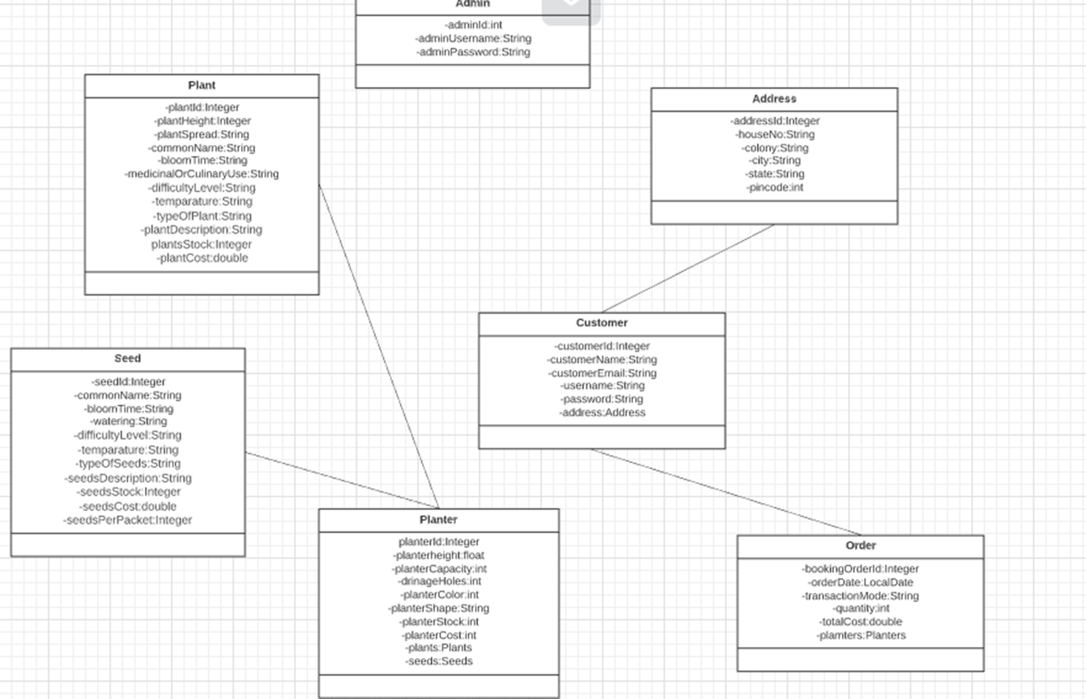
Class Diagram

Slide 7
Features
Features of Plant Module :
Admin can add plants.
Customer can see Plant details .
Customers can see Plant category.
Features of Planter Module :
Admin can add planters.
Customer can see Planter details.
Customers can see Planter category.
Features of Seed Module :
Admin can add seeds.
Customer can see Seed details.
Customers can see Seed category.
Features of order module:
Admin can view all orders.
Admin can also view orders based on plant, seed and planter.
Customer can place order and can also see the order details.
Features of review module:
Admin can view all the reviews.
Customer can give the review for the ordered products.
Customer can also view the review for the particular product given by the other customers.

Slide 8
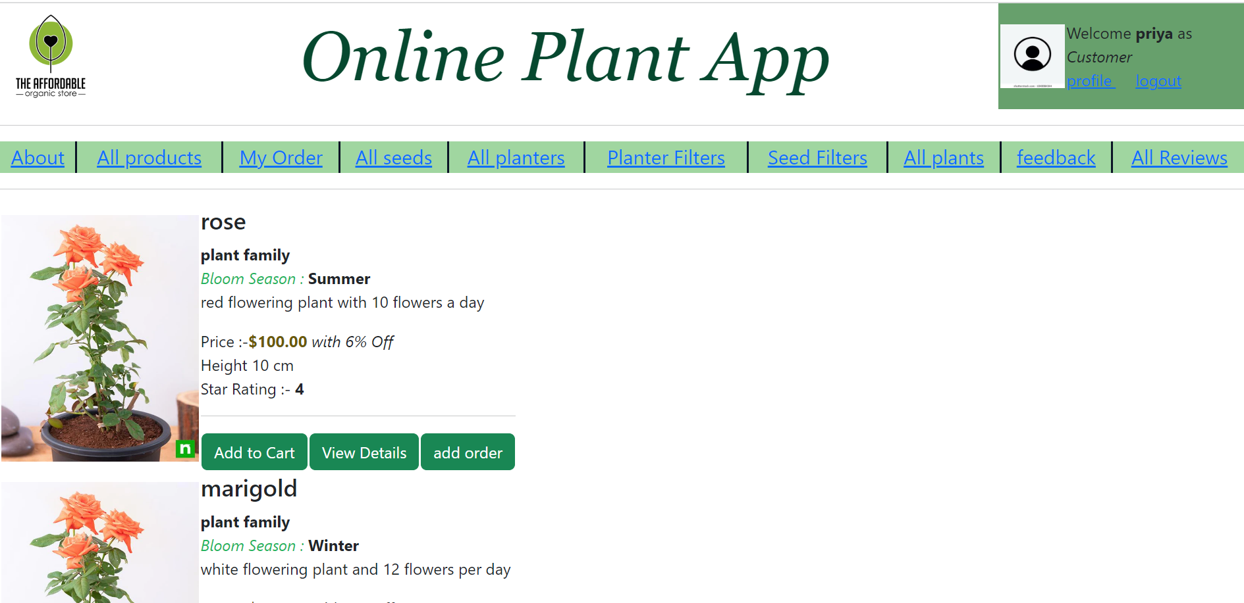
User Interface

Slide 9
Styling – Bootstrap & CSS
Bootstrap
Bootstrap by your side, heave a sigh of relief when it comes to displaying your landing page across multiple browsers. Its compatibility with Google Chrome, Firefox, Safari, and Internet Explorer makes it more versatile.
CSS:
Cascading sheet not only simplifies website development, but also simplifies the maintenance as a change of one line of code affects the whole web site and maintenance time. It is less complex therefore the effort are significantly reduced. It helps to form spontaneous and consistent changes

Slide 10
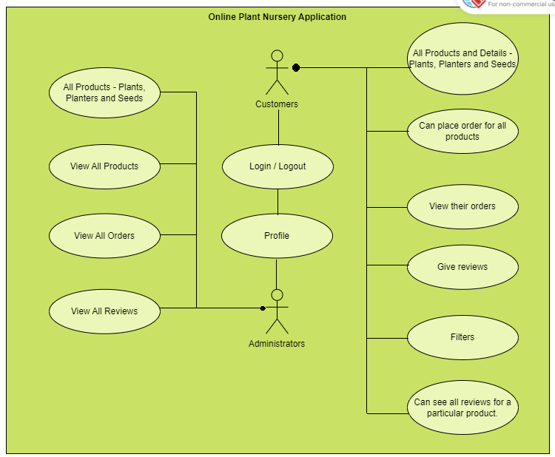
Architecture
Add Products

Slide 11
Future Development
Improved User Experience
Personalization
Better development for customer module.

Slide 12
Routers
{path:'about',component:AboutComponent},
{path:'launchproduct',component:LaunchNewProductComponent},
{path:'products',component:ViewAllProductsComponent},
{path:'productDetail/:pid',component:ViewDetailsComponent},
{path:'order',component:OrdersComponent},
{path:'orderList',component:OrdersListComponent},
{path:'orderListOnCategory',component:OrdersOnCategoryComponent},
{path:'addOrder',component:AddOrderComponent},
{path:'completeOrder',component:PlantsComponent},
{path:'addSeed',component:AddSeedComponent},
{path:'SeedsAvailable',component:SeedVarietiesComponent},
{path:'seedDetails',component:ViewSeedComponent},

Slide 13
{path:'seedDetails',component:ViewSeedComponent},
{path:'addPlanter',component:AddPlantersComponent},
{path:'PlantersAvailable',component:AllPlantersComponent},
{path:'planterDetails',component:ViewPlanterComponent},
{path:'planterFilters',component:PlanterFilterationsComponent},
{path:'seedFilters',component:SeedFiltersComponent},
{path:'addPlant',component:AddPlantComponent},
{path:'PlantsAvailable',component:AllPlantsComponent},
{path:'plantDetails',component:ViewPlantComponent},
{path:'feedback',component:AddReviewComponent},
{path:'allReviews',component:AllSeedReviewsComponent},
{path:'viewreview',component:SeedReviewComponent},
{path:'addReview',component:OrderReviewComponent}

Slide 14
Conclusion
Online plant app depends on its user interface, accuracy of information, and functionality. It should be easy to navigate, visually appealing, and provide reliable and up-to-date information. The app should also be regularly updated with new features and improvements to enhance the user experience.
It can be a valuable resource for anyone interested in plants, gardening, and can help promote environmental awareness and sustainability.

Slide 15
Thank You

